Slide 1
Transfer data from Local MySQL data to AWS Glue
Using
Connections & Connectors

Slide 2
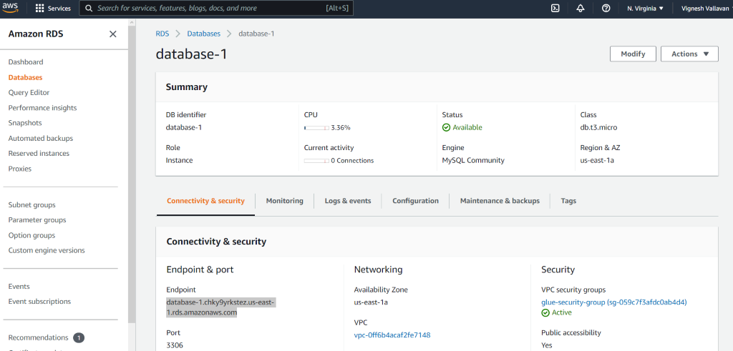
1. RDS setup in local MYSQL database https://youtu.be/Ng_zi11N4_c
2. RDS – JDBC Connection https://youtu.be/UUoQAe_NzaA
1. Create RDS
While creating RDS, remember username and password
Copy Endpoint name and paste it in to the hostname in local MySQL workbench

Slide 3
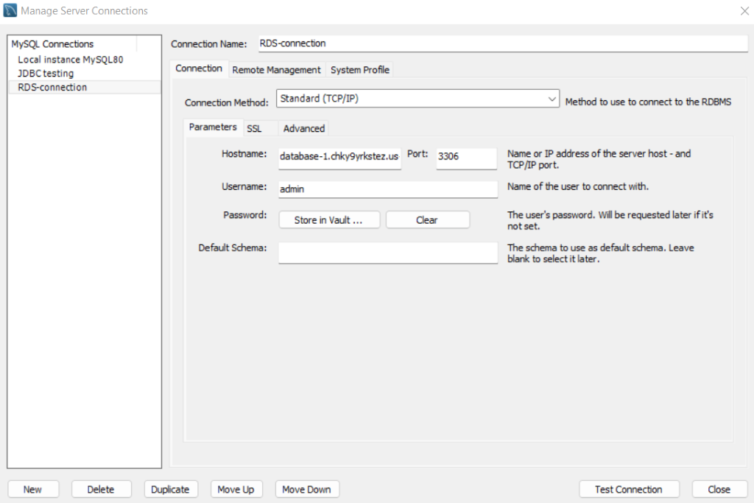
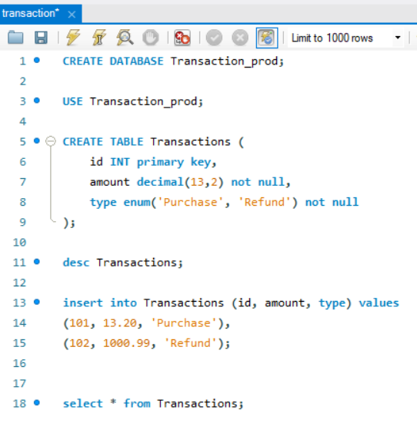
Local MySQL server connection Window
Test connection: If it returns an error--> Please change Security Groups in RDS
If it returns successfully, then starts SQL query

Slide 4
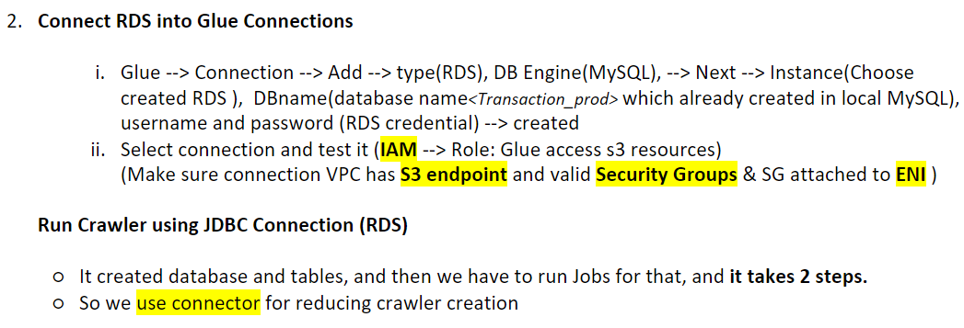

Slide 5
Connectors

Slide 6
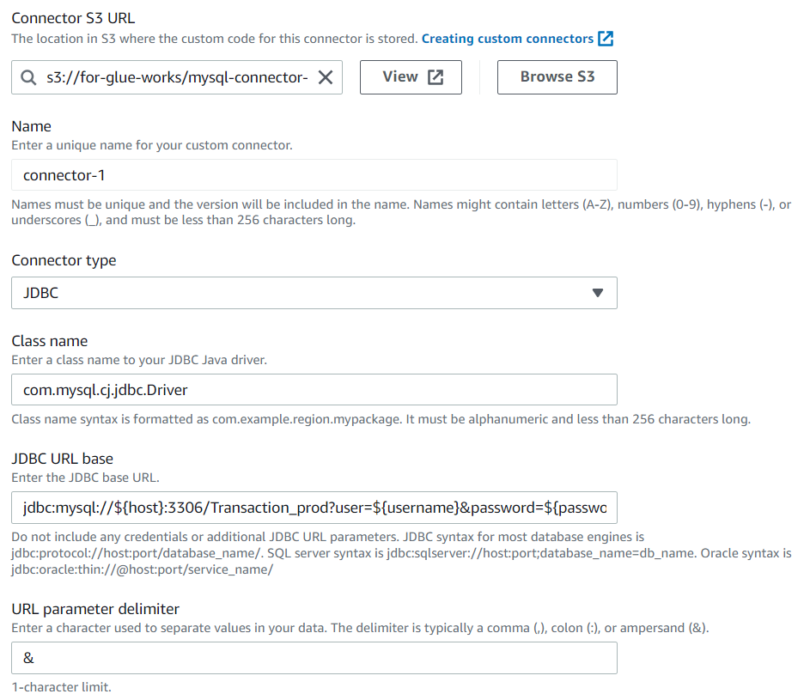
1. Create Connector in Glue Studio
MySQL connector in JAR format
mysql --> Protocol
Transaction_prod --> Database Name
Have to assign in Creation of connection
host
username
password

Slide 7
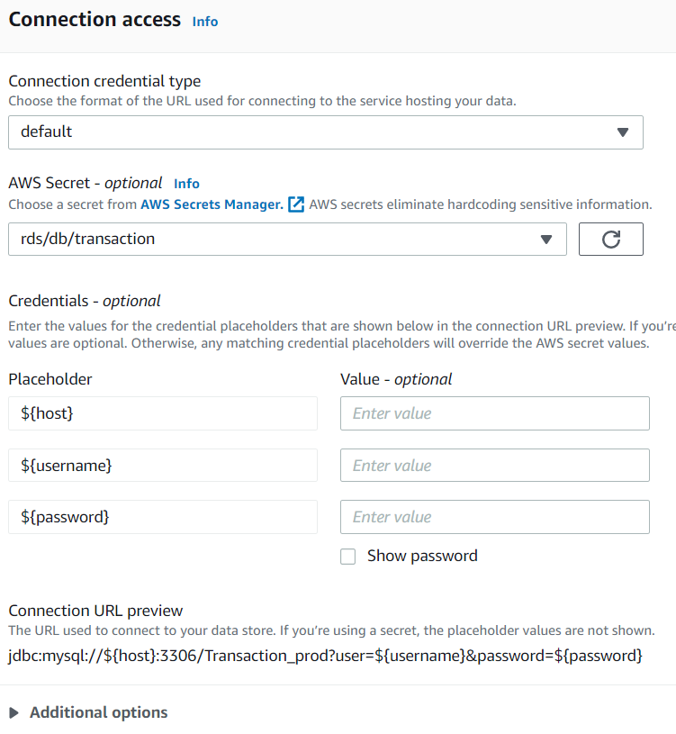
2. Create connection for connector in Glue Studio
Connectors --> open created connector --> Create Connection (top right corner)
If you does not add AWS secret, you will must give credentials. Otherwise its optional

Slide 8
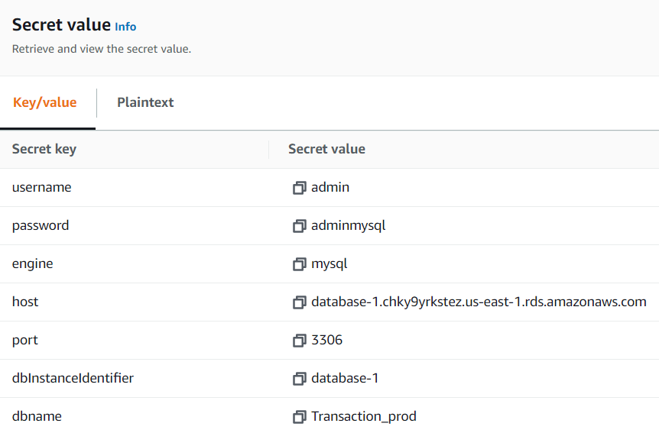
Create Secret Manager
RDS DB Name
Table created under Database

Slide 9
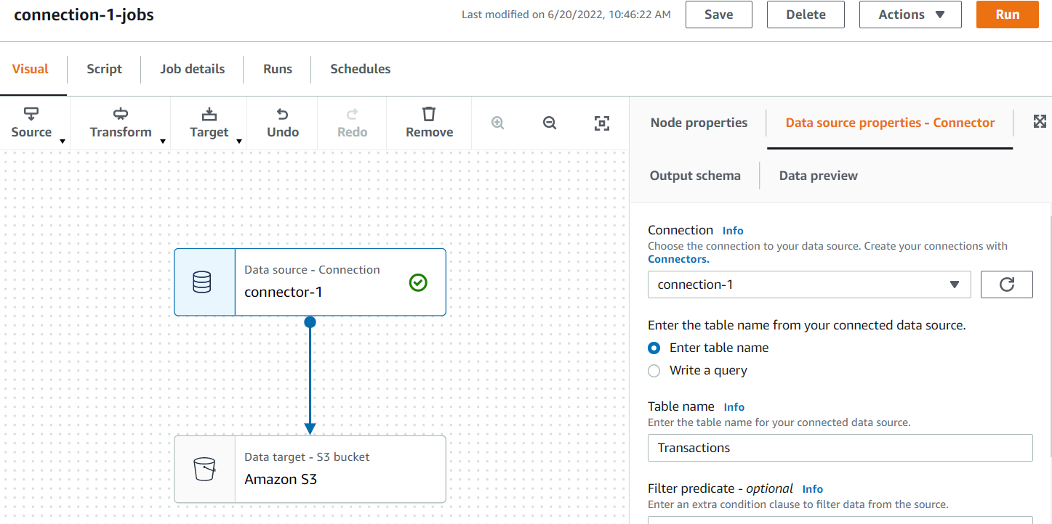
3. Create Jobs in Glue Studio
Correct table name that Database(Transaction_prod) have

Slide 10
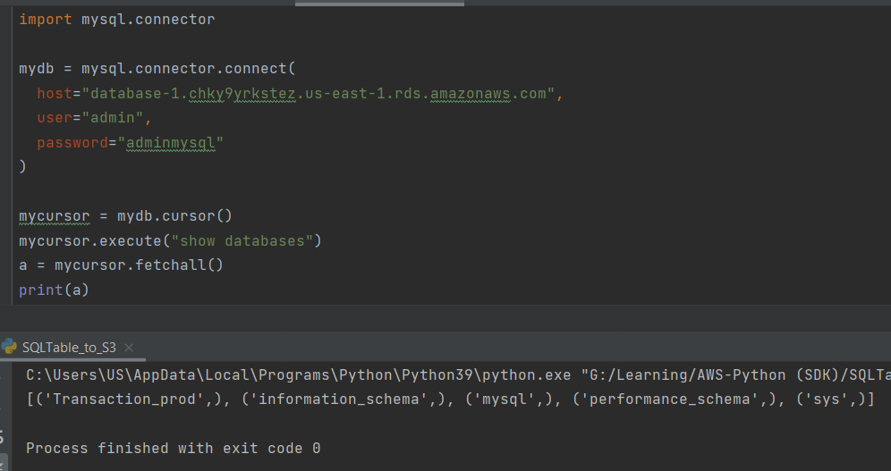
Connect MySQL in Python Using mysql-connector-python library
In snippet,
host = "<RDS Endpoint name>"

